Slide 1
Chapter 5 Making Decisions
Notes:
The order in which the statements of a program are executed is the flow of control. When the next statement to be executed is not the next one in the sequence, that is a transfer of control.

Slide 2
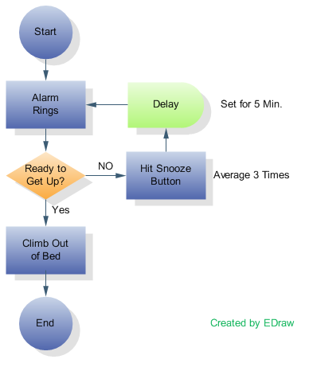
Flow of Control
Flow of control
The order in which statements are executed
Transfer of control
When the next statement executed is not the next one in sequence
Notes:
The order in which the statements of a program are executed is the flow of control. When the next statement to be executed is not the next one in the sequence, that is a transfer of control.

Slide 3
Flow of Control
Control structures
combination of individual statements into a logical unit that regulates the flow of execution in a program or function
Sequence
Selection (Making Decisions)
Repetition (Looping)
Notes:
In structured programming, there are three structures:
Sequence – one statement after another
Selection – when you make a decision
Repetition – also called looping which as we will see in chapter 4, also involves making a decision

Slide 4
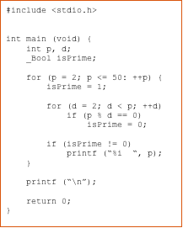
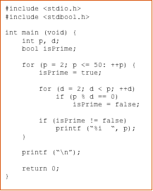
Review of Boolean Types
C type _Bool bool if #include <stdbool.h>
Notes:
Example on left uses C _Bool type, which has a value of either 1 or 0.
Example on right uses the stdbool.h library, which allows you to use bool type, which then has values of true or false.

Slide 5
Boolean Expressions
Expression that evaluates to true or false
Forms
Relational expression: <expr> <relational operator> <expr>
Examples:
7 < 5
a + b > 6
Logical expression: <Boolean expr> <logical operator> <Boolean expr>
Examples:
(x < 7) && (y > 3)
Notes:
To make decisions, we use a Boolean expression. All Boolean expressions evaluate to either true or false. They can be a relational expression or a logical expression.
Relational expressions are of the form “expression – relational operator – expression”. For example, 7 less than 5 or for example, a + b > 6.
Logical expressions are of the form “Boolean expression – logical operator – Boolean expression”. For example, x less than 7 AND y greater than 3.

Slide 6
Relational Operators
4th: Ch 4 p. 46
3rd: Ch 5 p. 46
Notes:
The less than relational operator is the open angle bracket or left arrow. If you write x < y, you are asking for C to check the relationship between x and y and determine if x is less than y. In algebra if we wanted to check less than or equal to, we would place a line under the less than. Computers don’t have this character on the keyboard so in C we follow the less than with an equal sign.
The greater than symbol is the close angle bracket or right arrow. Like the less than if we want to indicate greater than or equal to, we follow the greater than with an equal sign.
Equality in algebra is indicated with an equal sign. In C we have already used the equal sign for the assignment operator, so C uses an equal-equal or double equal to test for equality. If you only use one equal in a Boolean expression, you will get a warning from C. You should correct the expression unless you really wished for assignment to take place within the expression.
Inequality in algebra is a forward slash through an equal sign. Since we don’t have that on a keyboard, C uses an exclamation, which means not, followed by an equal sign.

Slide 7
Logical Operators (Compound Relationals)
Ch 6 p. 72
&& (logical AND)
Returns true if both conditions are true
|| (logical OR)
Returns true if either of its conditions is true
! (logical NOT, logical negation)
Is a unary operator, only takes one operand following
Reverses the truth/falsity of its condition
Returns true when its condition is false
Notes:
We will look at three logical operators. The first two are also called compound relationals.
The double ampersand (and signs) is a logical AND. It evaluates to true if both the left hand Boolean expression is true and also the right hand Boolean expression is true. It not, it evaluates to false. It performs a short circuit evaluation. If the left hand expression is false, it will evaluate to false without evaluating the right.
The double stroke is a logical OR. The stroke appears above the back slash on most keyboards and may appear as two small strokes, one on top of the other. This logical operator evaluates to true if either the left hand expression or the right hand expression is true. If not, it evaluates to false. It also performs a short circuit evaluation. If the left hand expression is true, it will evaluate to true without evaluating the right.
The exclamation, as we have seen, indicates NOT. NOT is different from AND and OR in that it is a unary operator. It only has one operand which follows it. NOT turns a false into a true and a true into a false.

Slide 8
Logical Operators Truth Table
P | Q | P && Q | P || Q | !P
true | true | true | true | false
true | false | false | true | false
false | true | false | true | true
false | false | false | false | true
Notes:
This truth table shows the results of the logical operators on the possible values of two Boolean expressions. Given the possible values of expressions P and Q on the left, the remaining columns give the resulting evaluation for P OR Q, P AND Q, and NOT P.

Slide 9
Precedence of Operators
(), []
Unary +, unary -, !, ++, --
Type casting
* , / , %
+ , -
<, <=, >, >=
==, !=
&&
||
=
Table 5.1 Appendix A, pgs 443-444
Notes:
There is precedence between the different operators – the order in which operations will be done. First comes expressions enclosed in parentheses or brackets. We will see expressions in brackets when we get to arrays.
Next comes the unary operators +, -,!, ++, and -- and after that comes type casting. After type casting comes the numeric operators. First is multiplication, division, and mod and then comes addition and subtraction. After the numeric operators comes the inequality relational operators followed up by the equality relational operators. After that comes AND, then OR, and lastly the assignment operator.

Slide 10
The if Selection Structure
Branching
used when we want the computer to choose between two alternative courses of action
Notes:
The first C statement to implement a selection or decision structure is the if statement. It allows us to choose between two sets of actions.

Slide 11
The if Selection Structure
if Statement
Boolean
Expression
true
false
true block
Notes:
Here we see a graphical representation of the flow of logic, called a flowchart, for the if statement. As we come into the statement, a Boolean expression or condition is evaluated. If the expression is true then a block of code will be executed. If not, no statements are executed. The true path and the false path meet and continue to the next statement.

Slide 12
The if Selection Structure
General form of if:
if (Boolean Expression) {
statement1;
statement2;
...
}
Notes:
The if statement starts with the keyword if and is followed by a Boolean expression enclosed in parentheses. That is followed by a basic block. If the basic block only consists of one statement, the enclosing braces are optional.

Slide 13
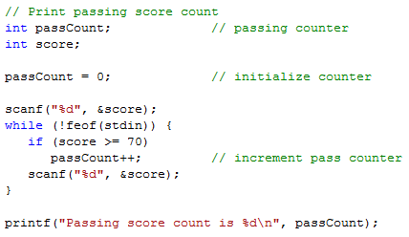
The if Statement from Chp 4
General form of if:
if (Boolean Expression) {
statement1;
statement2;
...
}
passing.c using redirect with input3.txt, input4.txt, or
input5.txt
Notes:
The if statement starts with the keyword if and is followed by a Boolean expression enclosed in parentheses. That is followed by a basic block. If the basic block only consists of one statement, the enclosing braces are optional.

Slide 14
Another if Statement Example
int age;
scanf(“%d”, &age);
if ((age >= 13) && (age <= 19)) {
printf("You are a teenager\n");
}
Notes:
This one uses the logical and operator && which will evaluate to true ONLY if both expressions are true.

Slide 15
The if-else Selection Structure
if
Only performs an action if the condition is true
if-else
A different action is performed when condition is true and when condition is false
Notes:
With the if statement, we could only perform a block of code if the expression is true. With an if-else we can perform different sets of statements depending on the value of the Boolean expression.

Slide 16
if-else Selection Structure
if-else statement
false
true
Boolean
Expression
false block
true block
Notes:
If we look at a flowchart for an if-else, we see that a Boolean expression is evaluated and if the result is true, a block of code, the true block, is executed. With the if-else, if the result is false, we can execute a different block of code, the false block. Again, the true path and the false path join at the end of the statement to proceed to the next statement.

Slide 17
The if-else Selection Structure
General form of if-else:
if (expression) {
statement1A;
statement2A;
...
}
else {
statement1B;
statement2B;
...
}
Notes:
The if-else starts off just like the if. After the true block comes the else keyword and then the false block.

Slide 18
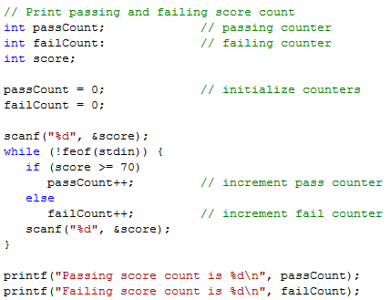
The if-else Statement from Chp4
General form of if-else:
if (expression) {
statement1A;
statement2A;
...
}
else {
statement1B;
statement2B;
...
}
passing2.c using redirect with input3.txt, input4.txt,
or input5.txt
Notes:
The if-else starts off just like the if. After the true block comes the else keyword and then the false block.

Slide 19
Another if-else Example
int age;
scanf(“%d”, &age);
if ((age >= 13) && (age <= 19)) {
printf("You are a teenager\n");
}
else {
printf("You are not a teenager\n");
}
Notes:
This one uses the logical and operator && which will evaluate to true ONLY if both expressions are true.

Slide 20
The if-else Selection Structure
Nested if-else structures
Test for multiple cases by placing if-else selection structures inside if-else selection structures.
Notes:
One or more of the statements inside of the true block or the false block can be another if-else or if. This is called nested ifs.

Slide 21
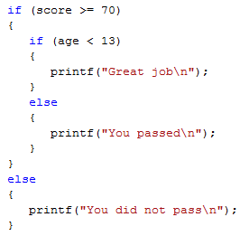
Nested if-else Structures
Notes:
In this example: If score is >= 70, print one of two messages depending whether age is less than 13, otherwise print the “did not pass” message. The test for age is nested within the test for score’s true block.
Note: Since the blocks of code only consist of one printf statement, they did not need to be enclosed in braces.

Slide 22
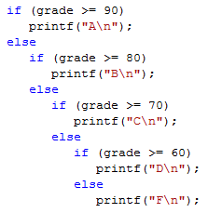
The if-else-if Construct
Once a condition is met, the rest of the statements are skipped
Notes:
This is another example of if-else and nested ifs. It prints a letter grade based on the numeric grade. Each nested if appears in the false block of the preceding if. Once a true condition is found, the grade is printed and the rest of the statements are skipped.

Slide 23
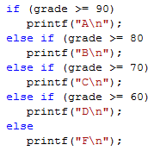
The if-else-if Construct
The standard way to indent the previous code is
Notes:
There is a better and shorter way to construct this code which is called the if-else-if. With this construct, the next if is placed on the same line and following the else. This results in less indention of the statements to the right.

Slide 24
The if-else Selection Structure
Compound statement:
Set of statements within a pair of braces
Example:
Notes:
If you want to execute multiple statements when a condition is true, you MUST enclose them in braces.
Based on the indention in this example with no braces, it looks like the programmer meant for both statements to be executed if the grade is greater than or equal to 90.

Slide 25
The if-else Selection Structure
Without the braces, only one statement is executed. e.g. given the following code:
The statement,
will be executed independent of the value of grade.
The statement,
will execute only if grade is
greater than or equal to 90.
Notes:
However, the second printf will always be executed. Only the first printf is dependent on the value of grade. So, braces are required in this case.

Slide 26
The dangling else
Note: the compiler matches an else with the closest unmatched if
The above will be treated as
Notes:
Remember that C is free form and doesn’t care about the indentation. It is only for the programmer.
In the first set of code, it appears that the else goes with the first if. However, the else will go with the closest prior unmatched unenclosed if.
How can we fix this so that it will compile like the top example looks?

Slide 27
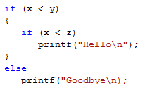
The dangling else
If the else is to match the outer if, use braces.
Notes:
If the else is to match the first if, the second if must be enclosed in braces.

Slide 28
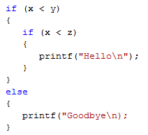
if-else Construct
To avoid confusion, and possible errors, it is best to use braces even for single statements.
However, code will be longer
{ }
Notes:
To avoid confusion and errors, you can always use braces. However, this is up to you. The resulting program may take up more lines of code.

Slide 29
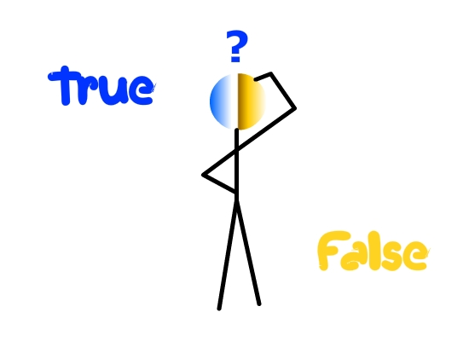
Conditional Expressions
C uses an integer to represent Boolean values
Zero is interpreted as false
Any other integer value is interpreted as true
not zero
zero
Notes:
C doesn’t truly have a Boolean type. It uses an integer instead. A value of zero is interpreted as false. Any other value will be interpreted as true.

Slide 30
Conditional Expressions
is not a syntax error in C.
The expression, n = 0, assigns zero to n and the value of the expression is 0. Zero is interpreted as false, and the false branch of the if statement will be taken.
is not a syntax error in C.
The expression assigns 5 to n. 5 is interpreted as true, and the true branch of the if statement will be taken.
Notes:
Using the assignment operator in the condition of an if is not a syntax error. The value of an assignment operation is the value that is placed in the destination.
With gcc, you will get a warning if you have an assignment as the conditional expression unless the assignment expression is enclosed in parentheses. The program will still run if you do not correct the warning. In the first example, n is assigned a zero and the conditional expression will have a value of zero. Zero is interpreted as false. In the second example, the conditional expression will have a value of 5. Five will be interpreted as true.

Slide 31
Conditional Expressions
==
Remember to use the == operator to test for equality.
To help catch the error when the equality check involves a constant, put the constant on the left hand side of the ==.
For example, use
instead of
Since is not a valid assignment in C, the compiler will detect this error when == is intended.
Notes:
Remember to use == for relational tests. You can place a constant on the left when checking an expression for a constant value and then if you use = instead of ==, you will get a syntax error.

Slide 32
The switch Multiple-Selection Structure
switch
Useful when variable or expression is tested for multiple values
Consists of a series of case labels and an optional default case
Notes:
If we are testing an expression for multiple values, an alternative to multiple ifs is the switch statement. If consists of the switch statement followed by a series of case labels and optionally a default case.

Slide 33
The switch Multiple-Selection Structure With Breaks
case a
case a action(s)
break
case b
case b action(s)
break
case z
case z action(s)
break
default action(s)
Notes:
This is a flow chart for a switch structure with break statements. Different cases are checked. If a match is found, a corresponding block is executed with a set of actions ending in a break statement. The break statement causes execution to go to the completion of the switch statement. You can have a default block of statements with actions to be done if none of the cases are matched.

Slide 34
The switch Multiple-Selection Structure Without Breaks
case a
case a action(s)
case b
case b action(s)
case z
case z action(s)
default action(s)
Notes:
If break statements are not there, execution will fall into the block for the next case without checking to see if that case is true and will continue until either a break statement or the end of the switch statement. We can actually use this to our advantage if we want to check for multiple values for a case.

Slide 35
switch Statement Syntax
switch (switch_expression) {
case constant1:
statementSequence1
break;
case constant2:
statementSequence2
break;
…
case constantN:
statementSequenceN
break;
default:
defaultStmtSequence
}
Notes:
The switch statement begins with the keyword switch, is followed by a switch expression enclosed in parentheses, and then last comes the body of the statement enclosed in braces. In the body are case statements which contain the keyword case, a constant to be compared to the switch expression value, and then a colon.
Following each case statement are statements to be executed when the constant is equal to the value of the switch expression value. There can also be a default statement which specifies a default case to be performed if none of the cases match the switch expression.
The optional but generally used break statement causes execution to flow to the next statement following the switch statement.

Slide 36
switch Statement
The switch_expression is compared against the values constant1, constant2, …, constantN
constant1, constant2, …, constantN must be simple constants or constant expressions.
Can be a char or an int
Best to use the same type constant as the switch expression
If not, a type conversion will be done.
Notes:
The constants in the case statements that are compared to the switch expression must be simple constants or constant expressions yielding a data type of char or int. If your switch expression is char, your constant should be a char constant. If your switch expression is an int, your constant should be an integer. If not, the constant will be converted to the type of the switch expression before the comparison is made.

Slide 37
switch Statement Reminder
The switch statement ends with
break statement
end of the switch statement
When executing the statements after a case label, it continues to execute until it reaches a break statement or the end of the switch.
If you omit the break statements, then after executing the code for one case, the computer will continue to execute the code for the next case.
Notes:
Remember: The switch statement will end when either execution gets to a break statement or it gets to the end of the switch statement. Once it starts executing statements, it continues until a break statement or the end ignoring case statements along the way. So if you leave out a break statement at the end of a case, execution will continue right into the next case’s statements.

Slide 38
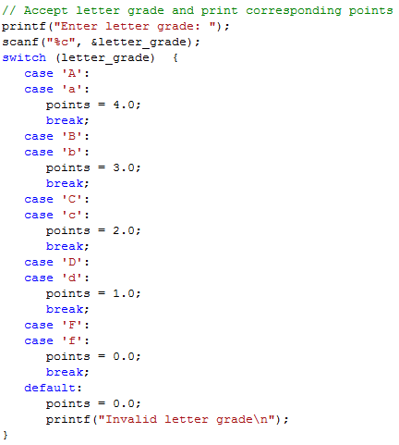
Example of switch
Notes:
In this example, we input a letter grade which can be in upper or lower case. We wish to print grade points based on a letter grade that we get from the user.
The first case is an upper-case A. If that matches letter_grade, execution will begin. There is no break statement in this case and in fact there are no statements. Execution continues into the next case’s statements so points are set to 4 and then the break is executed which ends the switch statement.
If a lower-case c was entered, letter_grade would be compared to A, a, B, b, C, and then c before a match is found. The variable points would then be set to 2 and the break statement would end the switch.
If the user entered an invalid letter grade, one not matching any of the case constants, the statements in the default case would be executed. Points would be set to zero and an error message would be printed.

Slide 39
Example of switch
printf(“Enter month number: “);
scanf(“%d”, &month);
switch(month) {
case 1:
case 3:
case 5:
case 7:
case 8:
case 10:
case 12:
printf(“The number of days is 31\n”);
case 4:
case 6:
case 9:
case 11:
printf(“The number of days is 30\n”);
default:
printf(“The number of days is 28 or 29\n”);
}
Notes:
What happens when user enters a 2? 6? 3?
2: The number of days is 28 or 29
6: The number of days is 30
The number of days is 28 or 29
3: The number of days is 31
The number of days is 30
The number of days is 28 or 29

Slide 40
Conditional Operators
condition ? expression1 : expression2
The condition is an expression, usually a relational expression, and is evaluated first. If it evaluates to TRUE, then expression1 takes place. If the condition evaluates to FALSE, then expression2 takes place.
printf(“Enter an integer: “);
scanf(“%d”, &x);
s = (x < 0) ? -1 : x * x;
printf(“%d\n”, s);
Notes:
If user enters a -3 for x, s is -1 and printf statement prints -1
If user enters a 4 for x, s is 16 and printf statement prints 16

